Slide 1


Trend Tracking:
Leverage Review Data for Industry Insight on Amazon
Chih-Hsin Peng, Gaurangi Agrawal, Jiacheng Li,
Ya Chu Hsu, Yi-Cheng Chung

Slide 2

Agenda
Motivation + Data Introduction
Pre-processing
Sentimental Analysis
Challenge
Conclusion

Slide 3

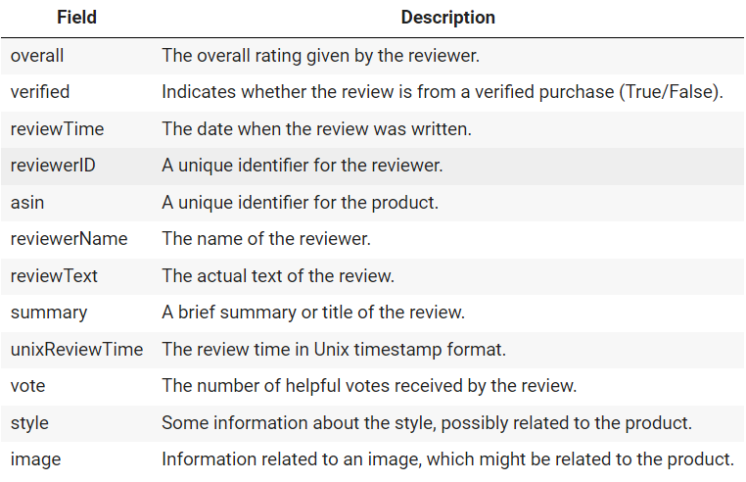
Data Description
📌
Amazon Fashion Review Data, sourced from UCSD Research
883,636 reviews
From 1998 to 2018
📌
📌
Notes:
besides talking about the dataset we use, also include the motivation

Slide 4
Pre-Processing
SAMPLING
NULL VALUE
DUPLICATES
• style, image: drop column
• reviewerName, reviewText, summary: drop null value
• vote: fill in N/A
row: 883,636 → 44,182
drop the duplicated value
REMAIN CHARACTER/ NUMBER/ SPACE
STOP WORD
LEMMATIZE
LOWER CASE
STEM
WORD TOKENIZE

Slide 5

Sentiment Analysis

Slide 6
Is there any relationship between original_summary
and extract_summary?
 | SUMMARY | SUMMARY(FROM ORIGIANL SUMMARY) | REVIEWTEXT(AFTER PRE-PROCESS) | SUMMARY(FROM REVIEWTEXT)
691612 | Entirely too small! | small | seem size way read review order size larger id... | read larger normal small
204341 | ... not even fit on my ear i would not recomme... | fit recommend are tiny | small even fit ear would recommend product tin... | recommend small fit
625152 | I thought I got the right size but apparently not ... | thought got right | thought got right size appar way small order size im cross dresser look cute way small | thought got look right appar small cute small
similarity between summary= 5.11 %

Slide 7
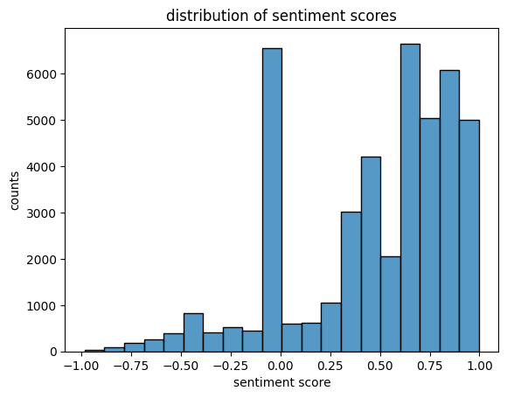
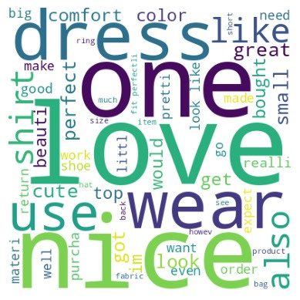
Classify emotional tones into 5 ranks
TONE | SENTITMENT SCORE
very positivge | x > 0.6
positive | 0.6 ≥ x >0.2
neutral | 0.2 ≥ x > -0.2
negative | -0.2 > x ≥ -0.6
very negative | -0.6 > x
Word Cloud

Slide 8
Compare the classified emotional tone with the overall rating to validate the accuracy of sentiment classification
INDEX | REVIEWTEXT (AFTER PRE-PROCESS) | SCORE | TONE
87569 | nut malo e cheap | 0.0000 | Neutral
691612 | seem size way read review order size larger id... | 0.0000 | Neutral
204341 | small even fit ear would recommend product tin... | 0.7351 | Very Positive
625152 | thought got right size appar way small order s... | 0.4588 | Positive
457145 | love wallet | 0.6369 | Very Positive
TONE | OVERALL RANKING | PERCENTAGE MATCH (%)
very positivge | 5 | 35.02 %
positive | 4 | 4.78 %
neutral | 3 | 2.78 %
negative | 2 | 0.92 %
very negative | 1 | 0.66 %

Slide 9
Top 3 Most Reviewed Categories by Sentiment Tone & Overall Ranking
EMOTION | ASIN | CATEGORY
Very Positive | B00I0VHS10 | Outdoor Activity
 | B000KPIHQ4 | Outdoor Activity
 | B00RLSCLJM | Accessories
Very Negative | B000KPIHQ4 | Outdoor Activity
 | B000V0IBDM | Accessories
 | B0017U1KBK | Furniture
OVERALL | ASIN | CATEGORY
5.0 | B000KPIHQ4 | Outdoor Activity
 | B00RLSCLJM | Accessories
 | B000V0IBDM | Accessories
1.0 | B00UJ6GUYA | Decoration
 | B000YFSR5G | Clothing
 | B00SH9BD0W | Accessories

Slide 10
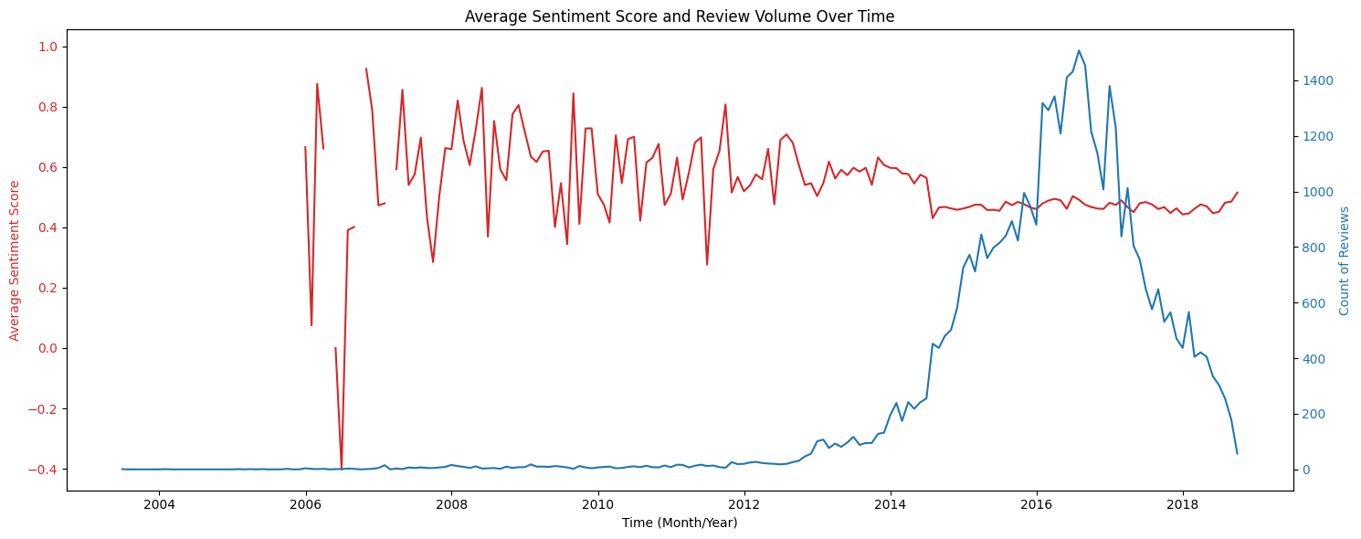
Average Sentiment Score and Reveiew Volumn Over Time
Notable volatility in the early 2000s, stabilizing after 2014, indicating consistent sentiment
Sentiment scores are consistently positive, leaning between 0.4 to 0.8

Slide 11
Challenge
Processing Limitations
PCA
Constraints of Word2Vec
condensed dataset to 1,078 components, capturing 80% variance
Extracting insights hindered by components.
5% of the original data
RAM collapse
Loss in accuracy
Expected clustering of positive, and negative words
Colab unable to process due to the size of dataset

Slide 12
Conclusion
Sentiment Classification
Insights
Deeper understanding of customer contentment and highlighting disparities within the reviews
Amazon can create strategies aligned with current market trends and leverage consumer feedback to refine products
A moderate alignment between the highest customer ratings ('5.0') and the sentiments expressed in the reviews
Reasonable effectiveness in capturing the nuances of customer emotions

Slide 13
Thank you!

